Slide 2
ET4730 Computer Graphics

Slide 3

Camera Movement
Lecturer: Nguyen Dinh Van, PhD.

Slide 4
Content
Camera movement
Delta time concept
Team Challenge

Slide 5
1. Camera Movement

Slide 6
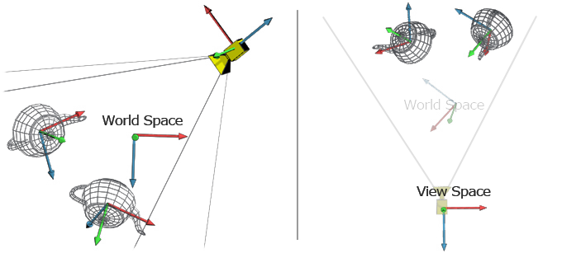
Reminder: Camera / View Space
View space: coordinate system that has origin at the camera position

Slide 7
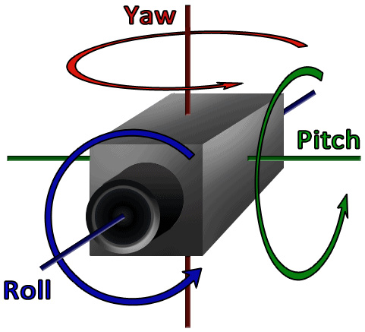
Camera Movement
Look around: Euler angles
3 values: Yaw, Pitch, Row
Can describe any rotation in 3D
Yaw: left right movement
Pitch: up down movement
Roll: rolling movement
(skip for now)

Slide 8
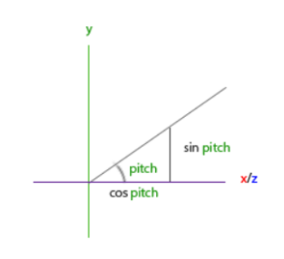
Camera Movement
Pitch: an angle in radian
y = sin(pitch)
x = cos(pitch)
z = cos(pitch)

Slide 9
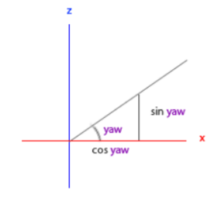
Camera Movement
Yaw: an angle in radian
x = cos(yaw)
z = sin(yaw)

Slide 10
Camera Movement
Pitch and Yaw: combined movement
x = cos(yaw) x cos (pitch)
y = sin(pitch)
z = sin(yaw) x cos (pitch)
Then use x,y,z to update the camera direction!

Slide 11
Camera movement
Strategy to move camera using mouse:
Store old mouse position
Compare to new position
Find pitch/yaw change using the difference
Update camera direction
Hint: using
glfwSetCursorPosCallback(window, callback);

Slide 12
Delta Time Concept

Slide 13
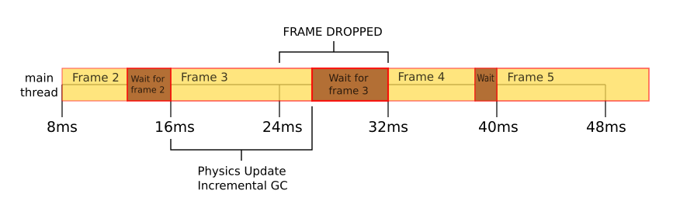
Delta time
Delta time:
Check how much time has passed since last event loop
Depends on physical machine and workload
Usage:
Camera smooth movement should be constant speed
Using delta time to calculate displacement of camera position:
Camera_pos = camera_pos + deltaTime * speed

Slide 14
Delta time
Fixed Delta time:
Simplest way
Define a fixed number ex: double dt = 1.0/60;
Use this fixed number in calculation
Problem:
In a real world system, it is impossible to pre-calculate the refresh rate / process rate of GPU
Movement could be faster or slower than intended.

Slide 15
Delta time
Variable Delta time:
Decalre a variable to keep track of time
E.g., double dt = getCurrentTime();
Calculate time change in the loop
i.e., dt = getCurrentTime() – dt;
Using the delta time as is.
Problem:
Complex physic simulation depends on the delta time calculated.
But detaTime depends on processing speed (less job to do, smaller deltaTime)
Hence inconsistent behavior

Slide 16
Delta time
Semi-fixed Delta time:
Similar to variable delta time
Declare an upper limit
Use only the minimum value between actual delta_time and upper limit
Why?
Ensure consistent behavior on slower machine
Allowing faster behavior on faster machine

Slide 17
Team Challenge

Slide 18
Team Challenge
Using information / given code structure, teams must perform following:
Draw a cube
Set up a camera
Move camera around using keyboard
Move camera around using mouse (optional)
Setup one-click action (hit one button and the camera move in a pre-defined behavior)
Evaluation:
In-complete project: -1 (midterm - team)
Complete project: 0
Exceptional (top 5): +1 (midterm – team)
No explanation/support will be given to any team.

Slide 19
THANK YOU !

